Slide 1

MARKET SHARE ANALYSIS
PERFECT PROJECT PRESENTATION

Slide 2


Team MEMBERS
JEYA SHREE
sravani
abHinandh
MAHI

Slide 3
INTRODUCTION
In this project, we use R to analyze and visualize market share in the banking sector. The focus is on creating a straightforward pie chart to reveal the dominance of banks and understand the dynamics between private and public sectors. The goal is to offer a simple yet powerful tool for stakeholders to gain quick insights into market composition.

Slide 4
Objectives
The objective of this project is to perform a market share analysis and visually represent the findings through a pie chart using the R programming language. This project focuses on analyzing the market share of different companies and sectors based on current market share holders data.

Slide 5
Innovations
ggplot2 Visualization-
Percentage Labels-
Dynamic Data Import-
Ethical Considerations-
Modular Design-

Slide 6


Data Collection & Analysis
Sources
STRUCTURE
Analysis
Financial reports of banks
Market research firms
-Official company statements
Continuous Monitoring
Reproducibility
Iterative Analysis
R programming language
ggplot2 for visualization
Rainbow colored pallete

Slide 7
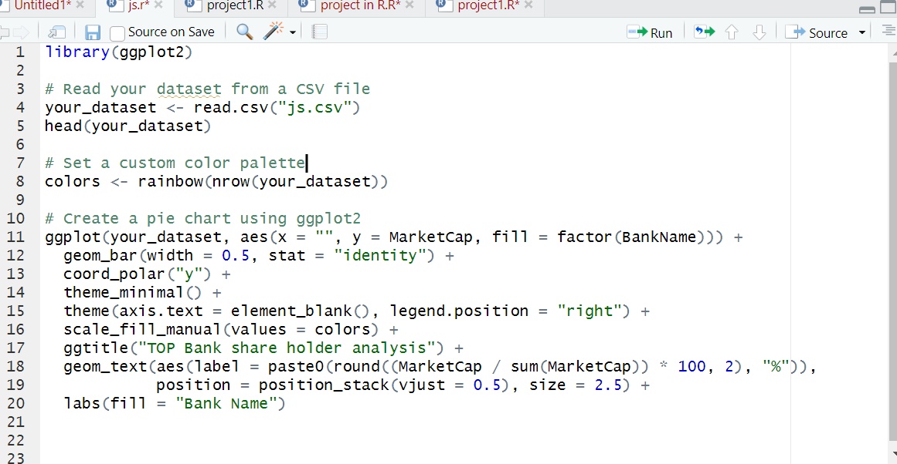


Code
Topic 02 comes here

Slide 8
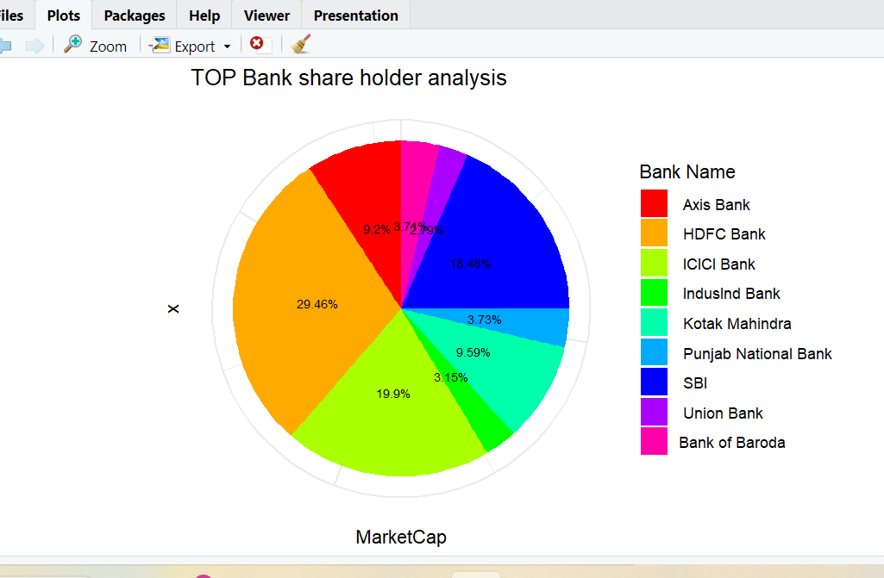
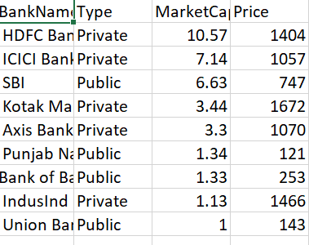
OUTPUT

Slide 9

conclusion
The market share analysis project, conducted using R, provides a clear visual representation of the distribution of market capitalization among banks. The i project make it a valuable tool for stakeholders seeking actionable insights in the dynamic banking sector. The comprehensive documentation enhances transparency and ensures the project's continued relevance with evolving datasets.

Slide 10

Thank you

